Slide 1
Online Courses
by:
Instructor:
Dr Mujahed Elayyat

Slide 2
LINKS:
Project Link :
Database File:

Slide 3
Introduction:
Our site is Online Courses ,The customer logs in to the site using his ID and Password password for his account, and then chooses what he/she want to do.
Functional Requirements:
1- Login
2- Dispaly Data
3- Search about Student
4-Add Student
5-Change Password
6-Delete Student

Slide 4
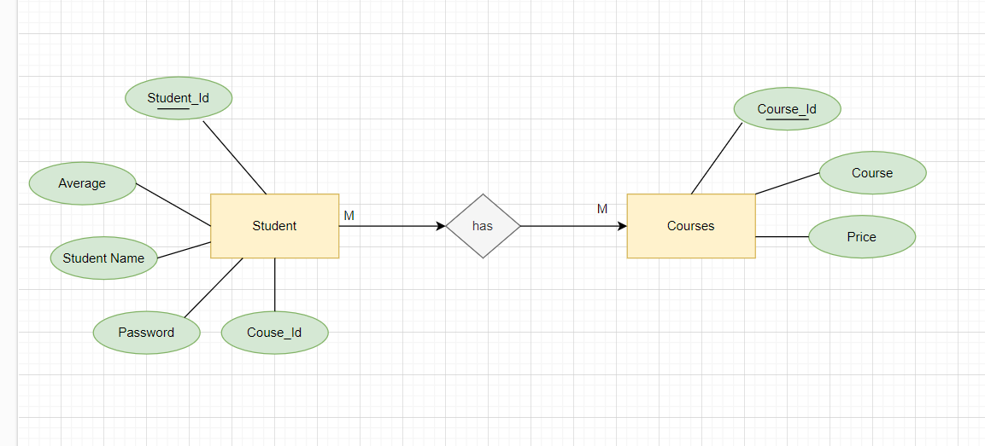
Database ERD:

Slide 5
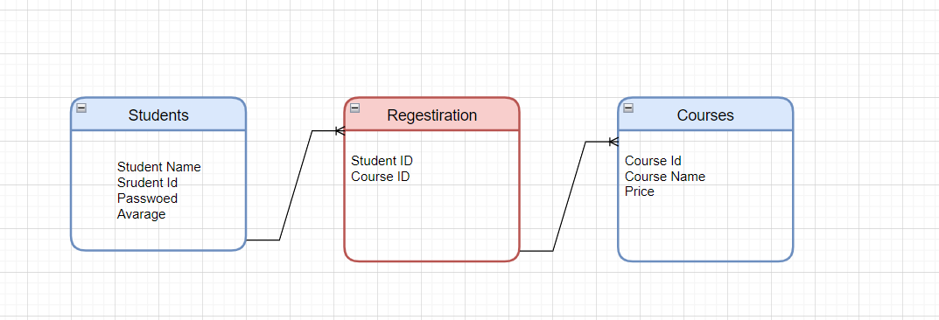
Relational tables :

Slide 6

Screenshots :
When open the website:

Slide 7
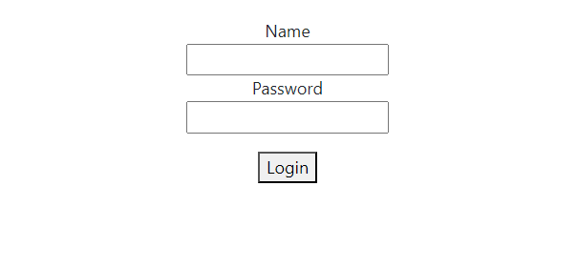
Then login by using ID and password:

Slide 8
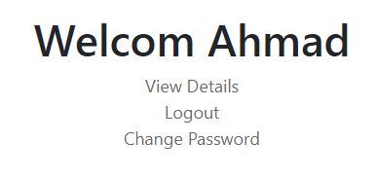
Then this Screen will display: You can choise to veiw data or logout or change password:

Slide 9
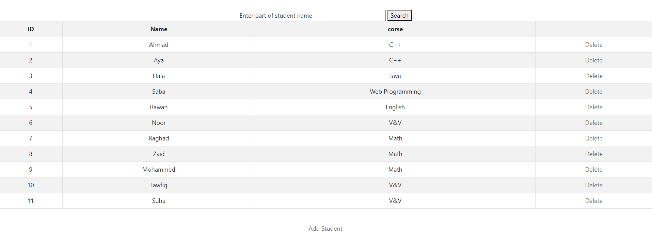
First , View data :Then you will see the Tabel and you can search about Course:

Slide 10
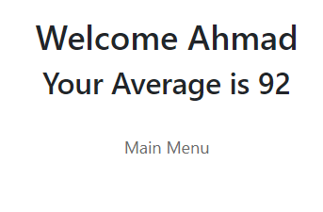
Also You can display student information :

Slide 11
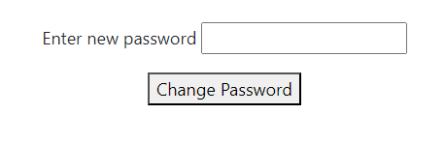
And of course you can change your password :

